Slide 1
Cloud Computing

Slide 2
Contents
History
Definition
Cloud Computing Architecture
Services
Features
Cloud Computing Tools
Some Commercial Cloud Offerings
Advantages of Cloud Computing
Limitations and disadvantages
Security and Privacy
References

Slide 3
History
Since 2000, cloud computing has come into existence.
In August 2006, Amazon introduced its Elastic Compute Cloud.
In April 2008, Google released Google App Engine in beta.
In early 2008, NASA's OpenNebula, enhanced in the RESERVOIR European Commission-funded project, became the first open-source software for deploying private and hybrid clouds, and for the federation of clouds.
In February 2010, Microsoft released Microsoft Azure, which was announced in October 2008.
In July 2010, Rackspace Hosting and NASA jointly launched an open-source cloud-software initiative known as OpenStack. The OpenStack project intended to help organizations offering cloud-computing services running on standard hardware.

Slide 4
History Cont…
On March 1, 2011, IBM announced the IBM SmartCloud framework to support Smarter Planet. Among the various components of the Smarter Computing foundation, cloud computing is a critical part.
On June 7, 2012, Oracle announced the Oracle Cloud. This cloud offering is poised to be the first to provide users with access to an integrated set of IT solutions, including the Applications (SaaS), Platform (PaaS), and Infrastructure (IaaS) layers.
In May 2012, Google Compute Engine was released in preview, before being rolled out into General Availability in December 2013.

Slide 5
Definition
Cloud Computing is a general term used to describe a new class of network based computing that takes place over the Internet,
a collection/group of integrated and networked hardware, software and Internet infrastructure (called a platform).
Using the Internet for communication and transport provides hardware, software and networking services to clients
Works on Distributed System Environment.
These platforms hide the complexity and details of the underlying infrastructure from users and applications by providing very simple graphical interface or API (Applications Programming Interface).
Strongly Supports Virtualization.
Cloud Types- Public and Private.

Slide 6
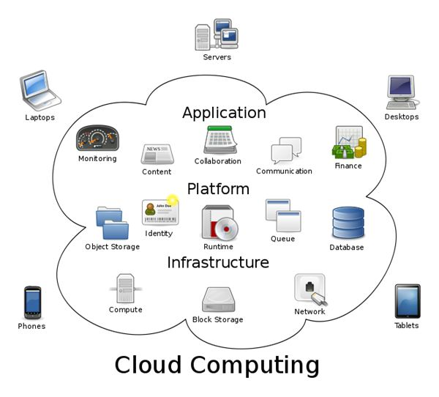
Cloud Computing Architecture

Slide 7
Services
SaaS-Software as a service is a software distribution model in which a third-party provider hosts applications and makes them available to customers over the Internet. SaaS is typically accessed by users using a thin client via a web browser.
Ex-Google Apps, Microsoft Office 365, Dropbox, Salesforce, CRM, Online Gaming, email (Gmail, Yahoo mail etc), Social Networking sites (Facebook etc)
PaaS- Platform as a service is a cloud computing model in which a third-party provider delivers hardware and software tools -- usually those needed for application development -- to users over the internet. A PaaS provider hosts the hardware and software on its own infrastructure. As a result, PaaS frees users from having to install in-house hardware and software to develop or run a new application.
Ex- Online Compiler
IaaS- In an IaaS(Infrastructure as a service) model, a cloud provider hosts the infrastructure components traditionally present in an on-premises data center, including servers, storage and networking hardware, It refers to online services that provide high-level APIs
Ex- firewalls, Virtual OS

Slide 8
Virtualization
Run operating systems where the physical hardware is unavailable,
Easier to create new machines, backup machines, etc.,
Software testing using “clean” installs of operating systems and software,
Emulate more machines than are physically available,
Timeshare lightly loaded systems on one host,
Debug problems (suspend and resume the problem machine),
Easy migration of virtual machines (shutdown needed or not).

Slide 9
Features
Agility for organizations may be improved, as cloud computing may increase users' flexibility with re-provisioning, adding, or expanding technological infrastructure resources.
Cost reductions are claimed by cloud providers. A public-cloud delivery model converts capital expenditures (e.g., buying servers) to operational expenditure.
Device and location independence enable users to access systems using a web browser regardless of their location or what device they use.
Maintenance of cloud computing applications is easier, because they do not need to be installed on each user's computer and can be accessed from different places.
Performance is monitored by IT experts from the service provider, and consistent and loosely coupled architectures are constructed using web services as the system interface.
Resource pooling is the provider’s computing resources are commingle to serve multiple consumers using a multi-tenant model with different physical and virtual resources dynamically assigned and reassigned according to user demand. There is a sense of location independence in that the consumer generally have no control or knowledge over the exact location of the provided resource.

Slide 10
Features Cont…
Productivity may be increased when multiple users can work on the same data simultaneously, rather than waiting for it to be saved and emailed. Time may be saved as information does not need to be re-entered when fields are matched, nor do users need to install application software upgrades to their computer.
Reliability improves with the use of multiple redundant sites, which makes well-designed cloud computing suitable for business continuity and disaster recovery
Resource pooling is the provider’s computing resources are commingle to serve multiple consumers using a multi-tenant model with different physical and virtual resources dynamically assigned and reassigned according to user demand. There is a sense of location independence in that the consumer generally have no control or knowledge over the exact location of the provided resource.
Productivity may be increased when multiple users can work on the same data simultaneously, rather than waiting for it to be saved and emailed. Time may be saved as information does not need to be re-entered when fields are matched, nor do users need to install application software upgrades to their computer.
Reliability improves with the use of multiple redundant sites, which makes well-designed cloud computing suitable for business continuity and disaster recovery.

Slide 11
Cloud Computing Tools
Cloud is not a new term and almost all enterprises use it in some way but the bottleneck is to manage the huge Cloud Infrastructure. There are many Cloud vendors those continuously provides new tools to help enterprise IT to build, buy, manage, monitor, tweak and track cloud services. But their fees might prick the companies budget pocket. So, here are some open source tools which help you to build, manage and monitor networks of virtual machines, private or hybrid clouds, tweak and track cloud services and much more…
1. OpenStack -OpenStack software allows data centers to pool the compute, storage, and networking resources and manage them through a dashboard or via the OpenStack API.
2. CloudStack-Apache CloudStack is designed to deploy and manage large networks of virtual machines. This Apache Project offers a turnkey Infrastructure as a Service (IaaS) cloud computing platform. It’s used both by public cloud computing vendors and by organizations running their own private clouds.
3. Eucalyptus-Eucalyptus allows organizations to easily migrate apps and data to build private or hybrid cloud environments that are compatible with Amazon Web Services.
4. Synnefo-Synnefo is a complete cloud infrastructure stack that provides Network, Image, Volume and Storage service. It manages Google Ganetti, OpenStack, and KVM.
5. FOSS-Cloud-The FOSS-Cloud is a Software that enables you to create your own Private or Public Cloud. It is an integrated infrastructure to provide cloud-Services, Windows or Linux based SaaS. FOSS-Cloud covers all of the aspects of an Open Source IT environment.This multi-faced cloud computing solution includes virtualization, cloud desktop, IaaS, PaaS and SaaS capabilities.

Slide 12
Cloud Computing Tools Cont…
6. openQRM-openQRM software manages a data center’s infrastructure to build private, public and hybrid IaaS (Infrastructure as a Service) clouds. This enterprise-class tool combines data center management system administration and IaaS provisioning into a single tool.
7. OpenShift-OpenShift’s helps you to make your job easier by taking care of all the messy IT aspects of app development and allows you to focus on your job by Coding your Application and satisfying your customers.
8. Cloud Foundry-Cloud Foundry is used to deploy your applications on a variety of infrastructures, including Amazon Web Services, OpenStack, and vSphere. It supports Java, Ruby, and Node applications out of the box.
9. Docker-Docker provides a highly reliable, low-cost way to quickly build, ship, and run distributed applications at scale. It gives developers the freedom to define environments and create apps faster and easier and flexibility for IT ops to quickly respond to change.
10. Salt Stack-SaltStack software is easy enough to get running in seconds, scalable enough to manage tens of thousands of servers, and fast enough to control and communicate with them in milliseconds. SaltStack delivers a dynamic infrastructure communication bus used for remote execution, configuration management and much more.

Slide 13



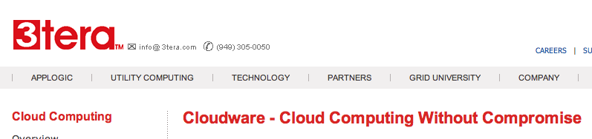

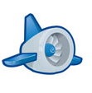

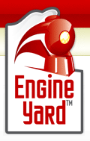


Some Commercial Cloud Offerings

Slide 14
Advantages of Cloud Computing
Lower computer costs:
You do not need a high-powered and high-priced computer to run cloud computing's web-based applications.
Since applications run in the cloud, not on the desktop PC, your desktop PC does not need the processing power or hard disk space demanded by traditional desktop software.
When you are using web-based applications, your PC can be less expensive, with a smaller hard disk, less memory, more efficient processor...
In fact, your PC in this scenario does not even need a CD or DVD drive, as no software programs have to be loaded and no document files need to be saved.

Slide 15
Advantages of Cloud Computing Cont…
Improved performance:
With few large programs hogging your computer's memory, you will see better performance from your PC.
Computers in a cloud computing system boot and run faster because they have fewer programs and processes loaded into memory…
Reduced software costs:
Instead of purchasing expensive software applications, you can get most of what you need for free-ish!
most cloud computing applications today, such as the Google Docs suite.
better than paying for similar commercial software
which alone may be justification for switching to cloud applications.

Slide 16
Advantages of Cloud Computing Cont…
Instant software updates:
Another advantage to cloud computing is that you are no longer faced with choosing between obsolete software and high upgrade costs.
When the application is web-based, updates happen automatically
available the next time you log into the cloud.
When you access a web-based application, you get the latest version
without needing to pay for or download an upgrade.
Improved document format compatibility.
You do not have to worry about the documents you create on your machine being compatible with other users' applications or OSes
There are potentially no format incompatibilities when everyone is sharing documents and applications in the cloud.

Slide 17
Advantages of Cloud Computing Cont…
Unlimited storage capacity:
Cloud computing offers virtually limitless storage.
Your computer's current 1 Tbyte hard drive is small compared to the hundreds of Pbytes available in the cloud.
Increased data reliability:
Unlike desktop computing, in which if a hard disk crashes and destroy all your valuable data, a computer crashing in the cloud should not affect the storage of your data.
if your personal computer crashes, all your data is still out there in the cloud, still accessible
In a world where few individual desktop PC users back up their data on a regular basis, cloud computing is a data-safe computing platform!

Slide 18
Advantages of Cloud Computing Cont…
Universal document access:
That is not a problem with cloud computing, because you do not take your documents with you.
Instead, they stay in the cloud, and you can access them whenever you have a computer and an Internet connection
Documents are instantly available from wherever you are
Latest version availability:
When you edit a document at home, that edited version is what you see when you access the document at work.
The cloud always hosts the latest version of your documents
as long as you are connected, you are not in danger of having an outdated version

Slide 19
Advantages of Cloud Computing Cont…
Easier group collaboration:
Sharing documents leads directly to better collaboration.
Many users do this as it is an important advantages of cloud computing
multiple users can collaborate easily on documents and projects
Device independence.
You are no longer tethered to a single computer or network.
Changes to computers, applications and documents follow you through the cloud.
Move to a portable device, and your applications and documents are still available.

Slide 20
Limitations and disadvantages
The downside is that you will have limited customization options. Cloud computing is cheaper because of economics of scale. A restaurant with a limited menu is cheaper than a personal chef who can cook anything you want.
Fewer options at a much cheaper price: it's a feature, not a bug." He also suggests that "the cloud provider might not meet your legal needs" and that businesses need to weigh the benefits of cloud computing against the risks.
In cloud computing, the control of the back end infrastructure is limited to the cloud vendor only. Cloud providers often decide on the management policies, which moderates what the cloud users are able to do with their deployment.
Cloud users are also limited to the control and management of their applications, data and services.
Privacy and confidentiality are big concerns in some activities, might face problems regarding sensitive data that are not encrypted.
Cloud computing is beneficial to many enterprises; it lowers costs and allows them to focus on competence instead of on matters of IT and infrastructure. Nevertheless, cloud computing has proven to have some limitations and disadvantages, especially for smaller business operations, particularly regarding security and downtime.
Technical outages can occur sometimes when cloud service providers become overwhelmed in the process of serving their clients. This may result to temporary business suspension. Since this technology's systems rely on the internet, an individual cannot be able to access their applications, server or data from the cloud during an outage.

Slide 21
Security and Privacy
Cloud computing poses privacy concerns because the service provider can access the data that is in the cloud at any time. It could accidentally or deliberately alter or even delete information.
Many cloud providers can share information with third parties if necessary for purposes of law and order even without a warrant.
According to the Cloud Security Alliance, the top three threats in the cloud are Insecure Interfaces and API's, Data Loss & Leakage, and Hardware Failure—which accounted for 29%, 25% and 10% of all cloud security outages respectively. Together, these form shared technology vulnerabilities.
In a cloud provider platform being shared by different users there may be a possibility that information belonging to different customers resides on same data server. Therefore, Information leakage may arise by mistake when information for one customer is given to other.

Slide 22
Security and Privacy Cont…
It is said that hackers are spending substantial time and effort looking for ways to penetrate the cloud. "There are some real Achilles' heels in the cloud infrastructure that are making big holes for the bad guys to get into". Because data from hundreds or thousands of companies can be stored on large cloud servers,
hackers can theoretically gain control of huge stores of information through a single attack—a process he called "hyperjacking". Some examples of this include the Dropbox security breach, and iCloud 2014 leak. Dropbox had been breached in October 2014, having over 7 million of its users passwords stolen by hackers .By having these passwords, they are able to read private data as well as have this data be indexed by search engines (making the information public).

Slide 23
Security and Privacy Cont…
There is the problem of legal ownership of the data (If a user stores some data in the cloud, can the cloud provider profit from it?). Many Terms of Service agreements are silent on the question of ownership.
Physical control of the computer equipment (private cloud) is more secure than having the equipment off site and under someone else's control (public cloud).
Some small businesses that don't have expertise in IT security could find that it's more secure for them to use a public cloud. There is the risk that end users do not understand the issues involved when signing on to a cloud service (persons sometimes don't read the many pages of the terms of service agreement, and just click "Accept" without reading). investment from the user.

Slide 24
The Future
Many of the activities loosely grouped together under cloud computing have already been happening and centralised computing activity is not a new phenomena
Grid Computing was the last research-led centralised approach
However there are concerns that the mainstream adoption of cloud computing could cause many problems for users
Many new open source systems appearing that you can install and run on your local cluster
should be able to run a variety of applications on these systems

Slide 25
References
https://en.wikipedia.org/wiki/Cloud_computing.
https://azure.microsoft.com/en-in/overview/what-is-cloud-computing/.
http://searchcloudcomputing.techtarget.com/definition/cloud-computing.

